Slide 1
Using diffractions as passive source wavefields:
A traveltime moveout perspective
Benjamin Schwarz¹, Alexander Bauer² & Dirk Gajewski²
¹ Department of Earth Sciences, University of Oxford
² Institut of Geophysics, University of Hamburg, Wave Inversion Technology (WIT)

Slide 2
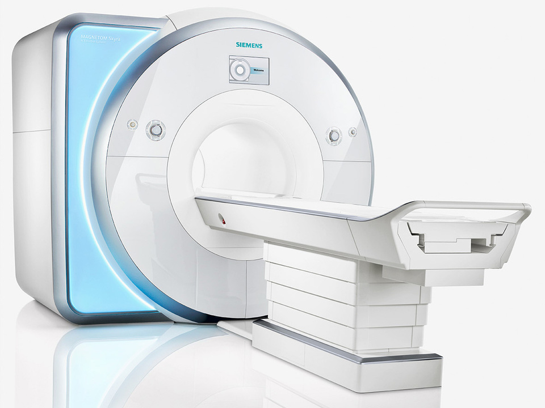
Motivation
(PGS)

Slide 3
Motivation
(PGS)

Slide 4
Motivation
(PGS)

Slide 5
Motivation
Near-offset channel
(PGS)

Slide 6
Outline
Diffraction: Solution to the illumination problem
Coherence analysis and wavefront measurements
Adaptive foreground subtraction using wavefront filters
Diffraction wavefront tomography
Field data examples:
  Industrial multi-channel acquisition (offshore Israel)
  Academic single-channel acquisition (near Santorini)
Summary & conclusions

Slide 7
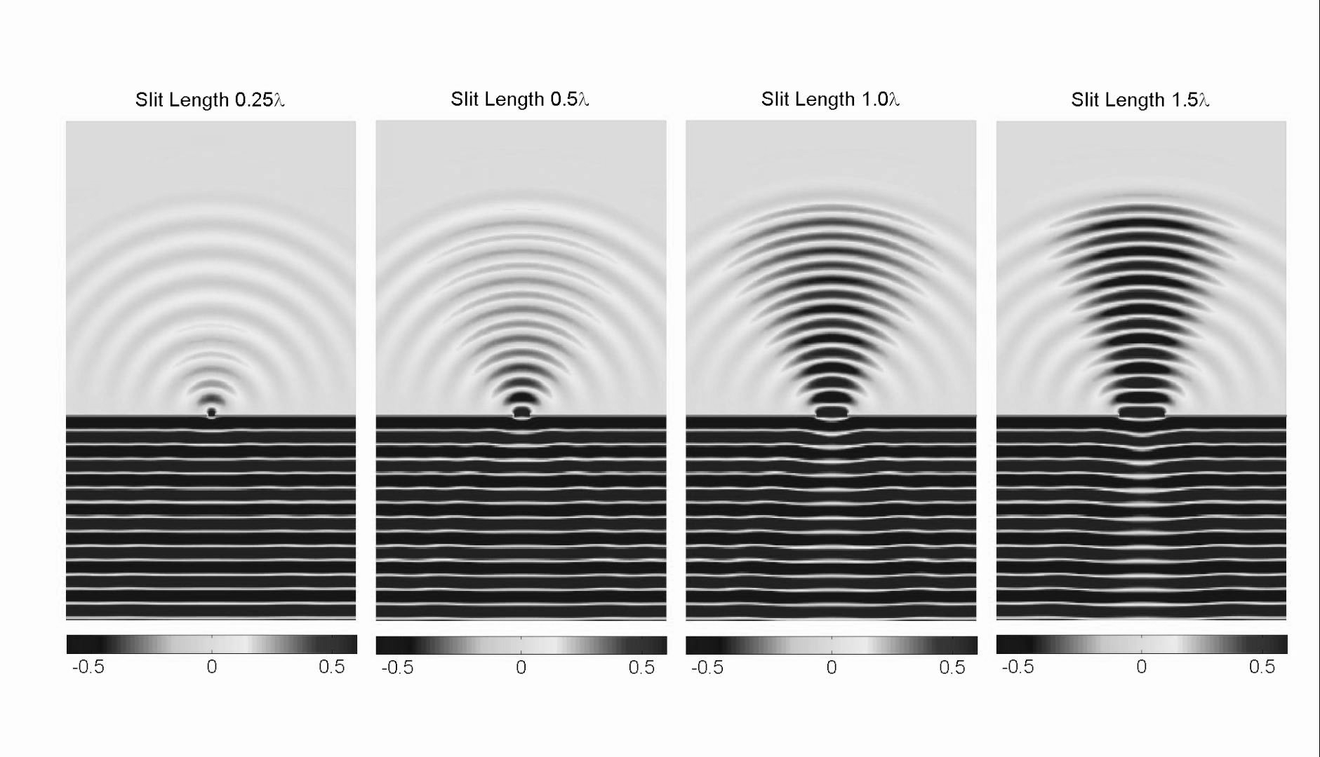
Diffraction
(meyavuz, youtube)

Slide 8
Diffraction
Occurs at faults, erosion surfaces, lithological edges, salt
Encodes super-resolved subsurface information
(beyond the Rayleigh limit)
Secondary (passive) sources / measured Green‘s functions
(no interface geometry signature, pure propagation)
Kinematic redundancy
(diffractions have same moveout in different trace gathers)
Problem: Diffractions are almost invisible!

Slide 9
Diffraction
Occurs at faults, erosion surfaces, lithological edges, salt
Encodes super-resolved subsurface information
(beyond the Rayleigh limit)
Secondary (passive) sources / measured Green‘s functions
(no interface geometry signature, pure propagation)
Kinematic redundancy
(diffractions have same moveout in different trace gathers)
Problem: Diffractions are largely invisible!

Slide 10
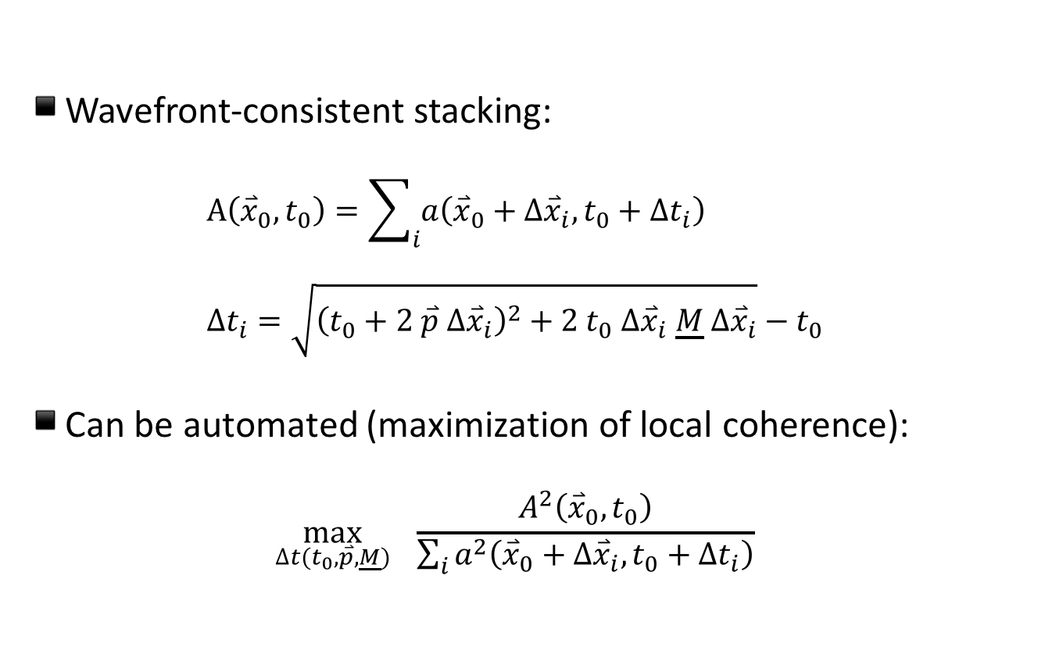
Coherence analysis
Wavefront-consistent stacking:
$A\left({\overset{⃑}{x}}_{0},t_{0}\right)=\sum_{i}{a\left({\overset{⃑}{x}}_{0}+{∆\overset{⃑}{x}}_{i},t_{0}+∆t_{i}\right)}$
$∆t_{i}=\sqrt{{\left(t_{0}+2 \overset{⃑}{p}{ ∆\overset{⃑}{x}}_{i}\right)}^{2}+{2 t}_{0} {∆\overset{⃑}{x}}_{i} \underline{M}{ ∆\overset{⃑}{x}}_{i}}−t_{0}$
Can be automated (maximization of local coherence):
$\max_{∆t(t_{0},\overset{⃑}{p},\underline{M})}{ \frac{A^{2}\left({\overset{⃑}{x}}_{0},t_{0}\right)}{\sum_{i}{a^{2}\left({\overset{⃑}{x}}_{0}+{∆\overset{⃑}{x}}_{i},t_{0}+∆t_{i}\right)}}}$

Slide 11
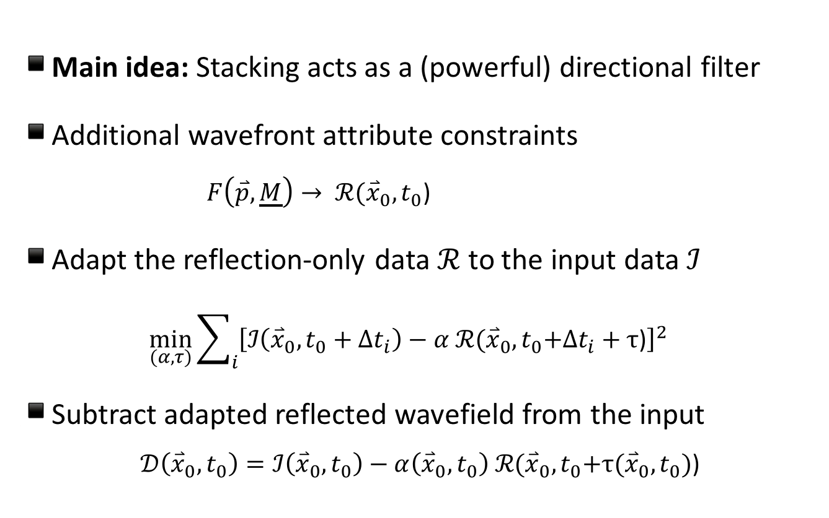
Adaptive foreground subtraction
Main idea: Stacking acts as a (powerful) directional filter
Additional wavefront attribute constraints
$F\left(\overset{⃑}{p},\underline{M}\right)→ ℛ({\overset{⃑}{x}}_{0},t_{0}$)
Adapt the reflection-only data $ℛ$to the input data $ℐ$
$\min_{(α,τ)}{\sum_{i}{{\left[ℐ\left({\overset{⃑}{x}}_{0},t_{0}+∆t_{i}\right)−α ℛ({\overset{⃑}{x}}_{0},t_{0}\text{+}∆t_{i}+τ\text{)}\right]}^{2}}}$
Subtract adapted reflected wavefield from the input
$𝒟\left({\overset{⃑}{x}}_{0},t_{0}\right)=ℐ\left({\overset{⃑}{x}}_{0},t_{0}\right)−α\left({\overset{⃑}{x}}_{0},t_{0}\right) ℛ({\overset{⃑}{x}}_{0},t_{0}\text{+}τ\text{(}{\overset{⃑}{x}}_{0},t_{0}\text{)}\text{)}$

Slide 12
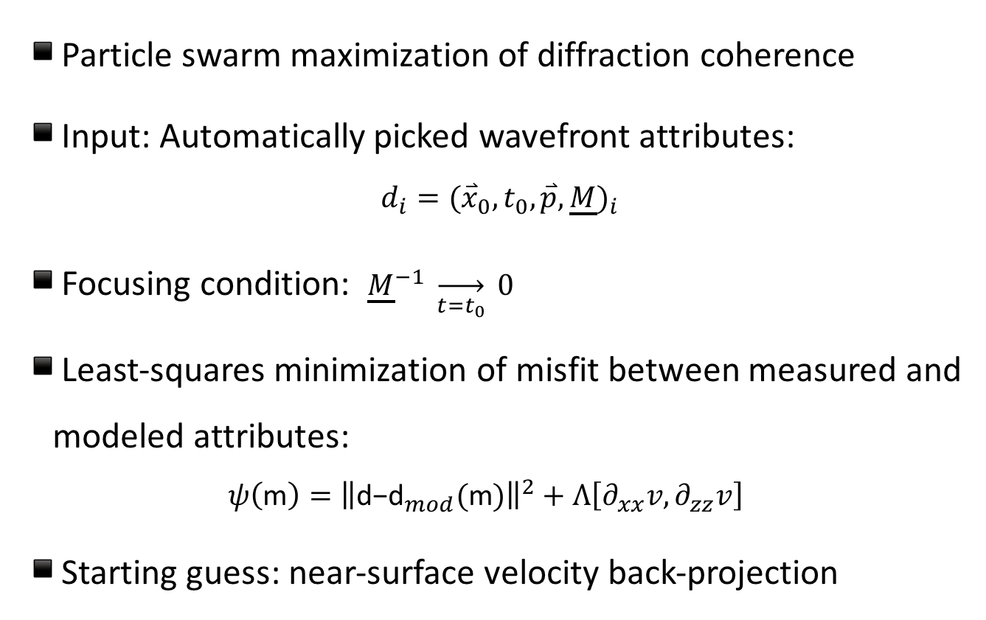
Diffraction wavefront tomography
Particle swarm maximization of diffraction coherence
Input: Automatically picked wavefront attributes:
${d_{i}=({\overset{⃑}{x}}_{0},t_{0},\overset{⃑}{p},\underline{M})}_{i}$
Focusing condition: ${\underline{M}}^{−1} \overset{→}{t=t_{0}} 0$
Least-squares minimization of misfit between measured and modeled attributes:
$ψ\left(\text{m}\right)={\left\|\text{d}\text{−}{\text{d}}_{mod}(\text{m})\right\|}^{2}+Λ\left[∂_{xx}v,∂_{zz}v\right]$
Starting guess: near-surface velocity back-projection

Slide 13
Workflow

Slide 14
Workflow

Slide 15
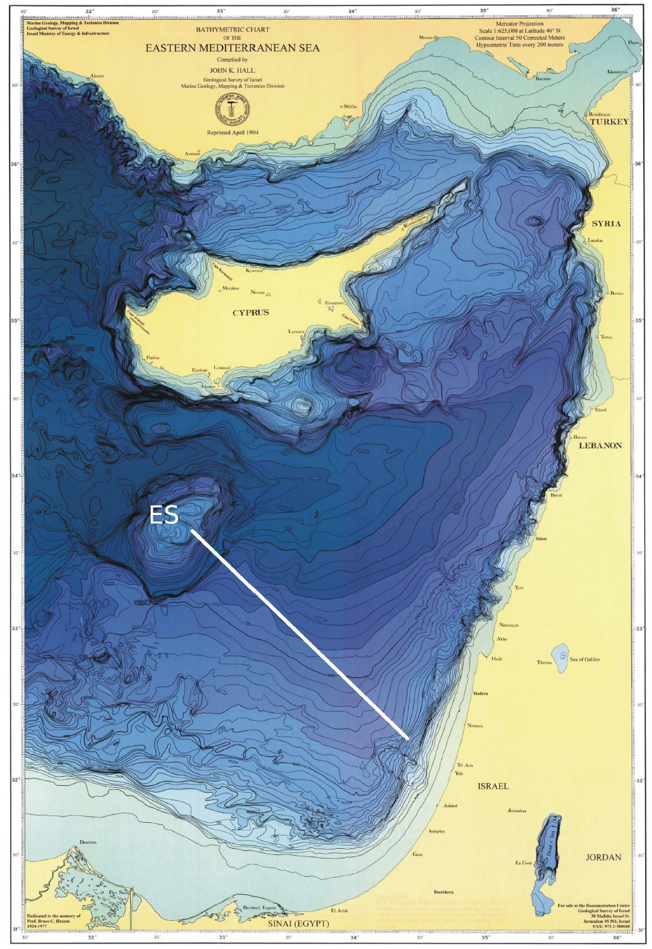
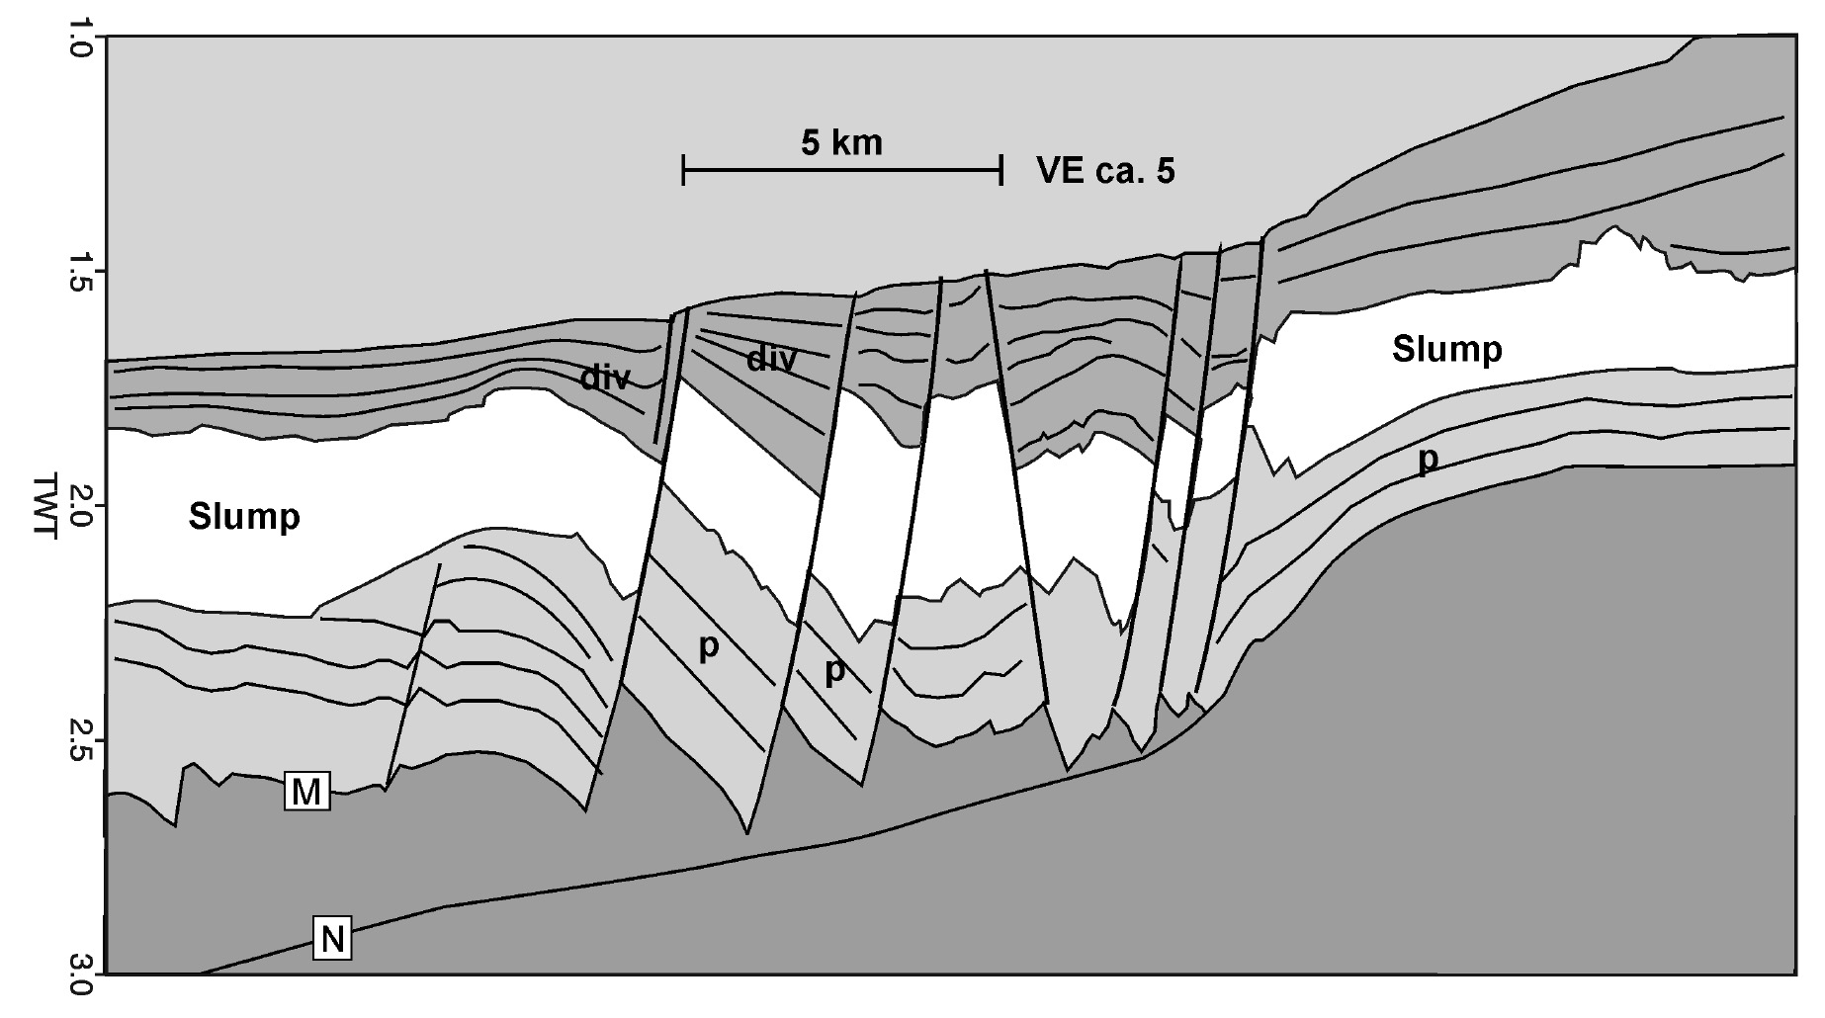
Industrial field data example
(left: Meier, 2007; right: Hübscher & Netzeband, 2007)

Slide 16
Industrial field data example

Slide 17
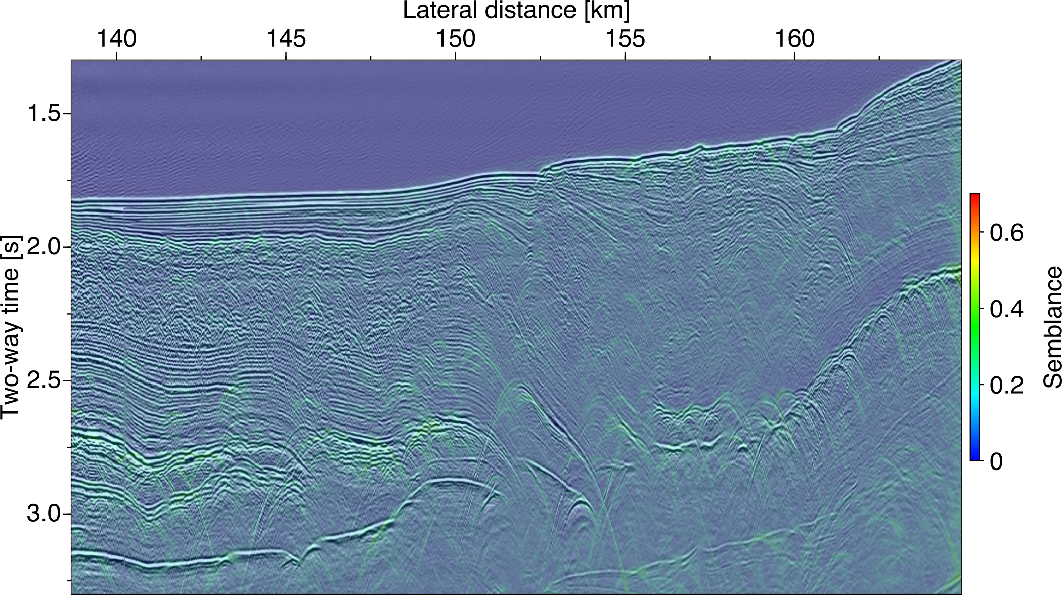
Diffraction background

Slide 18
Diffraction background

Slide 19
Automatic event picking

Slide 20
Near-surface back-projection

Slide 21
Diffraction wavefront tomography

Slide 22
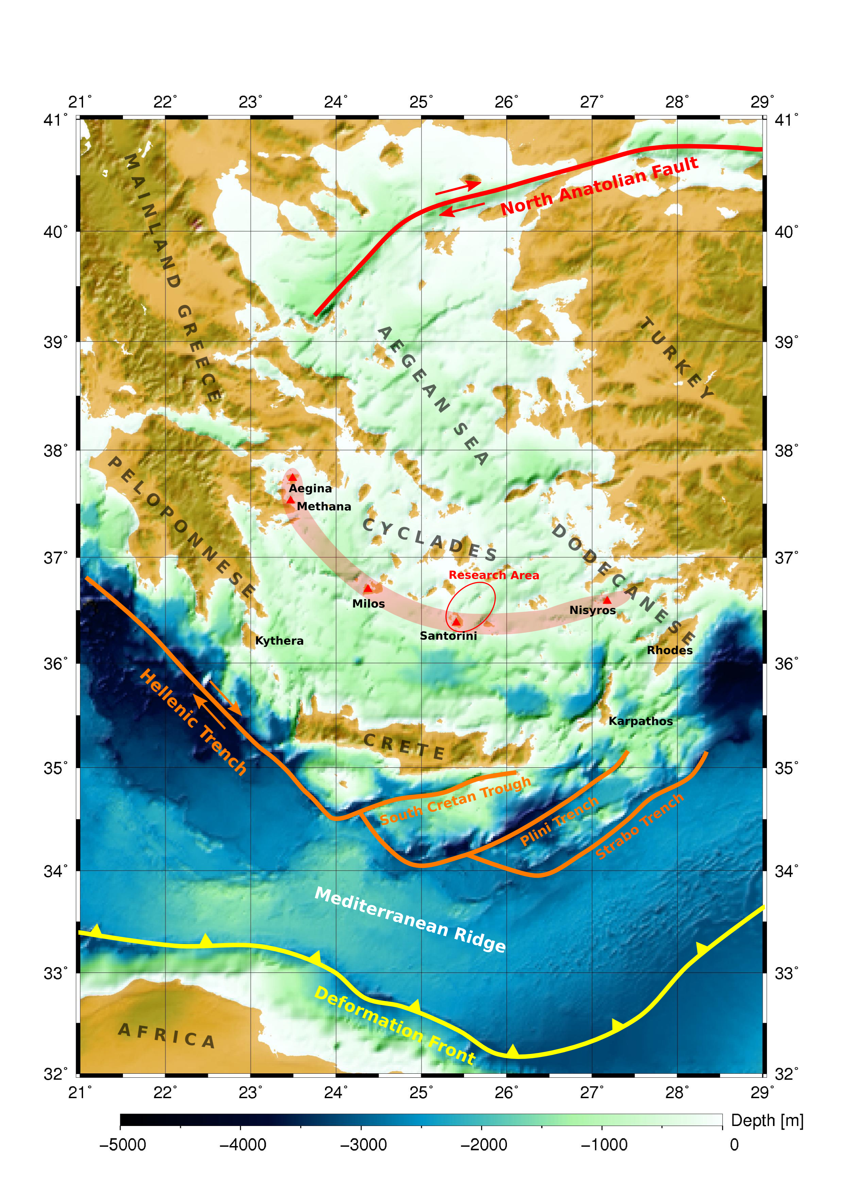
Academic field data example
(Ruhnau, 2011)

Slide 23
Academic field data example

Slide 24
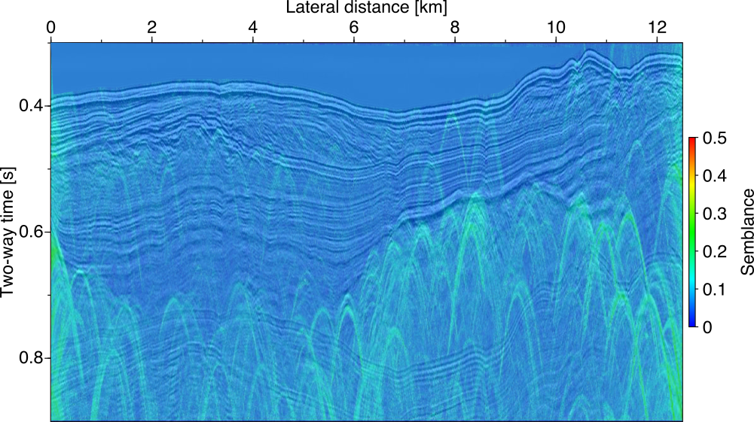
Diffraction background

Slide 25
Diffraction background

Slide 26
Automatic event picking

Slide 27
Near-surface back-projection

Slide 28
Diffraction wavefront tomography

Slide 29
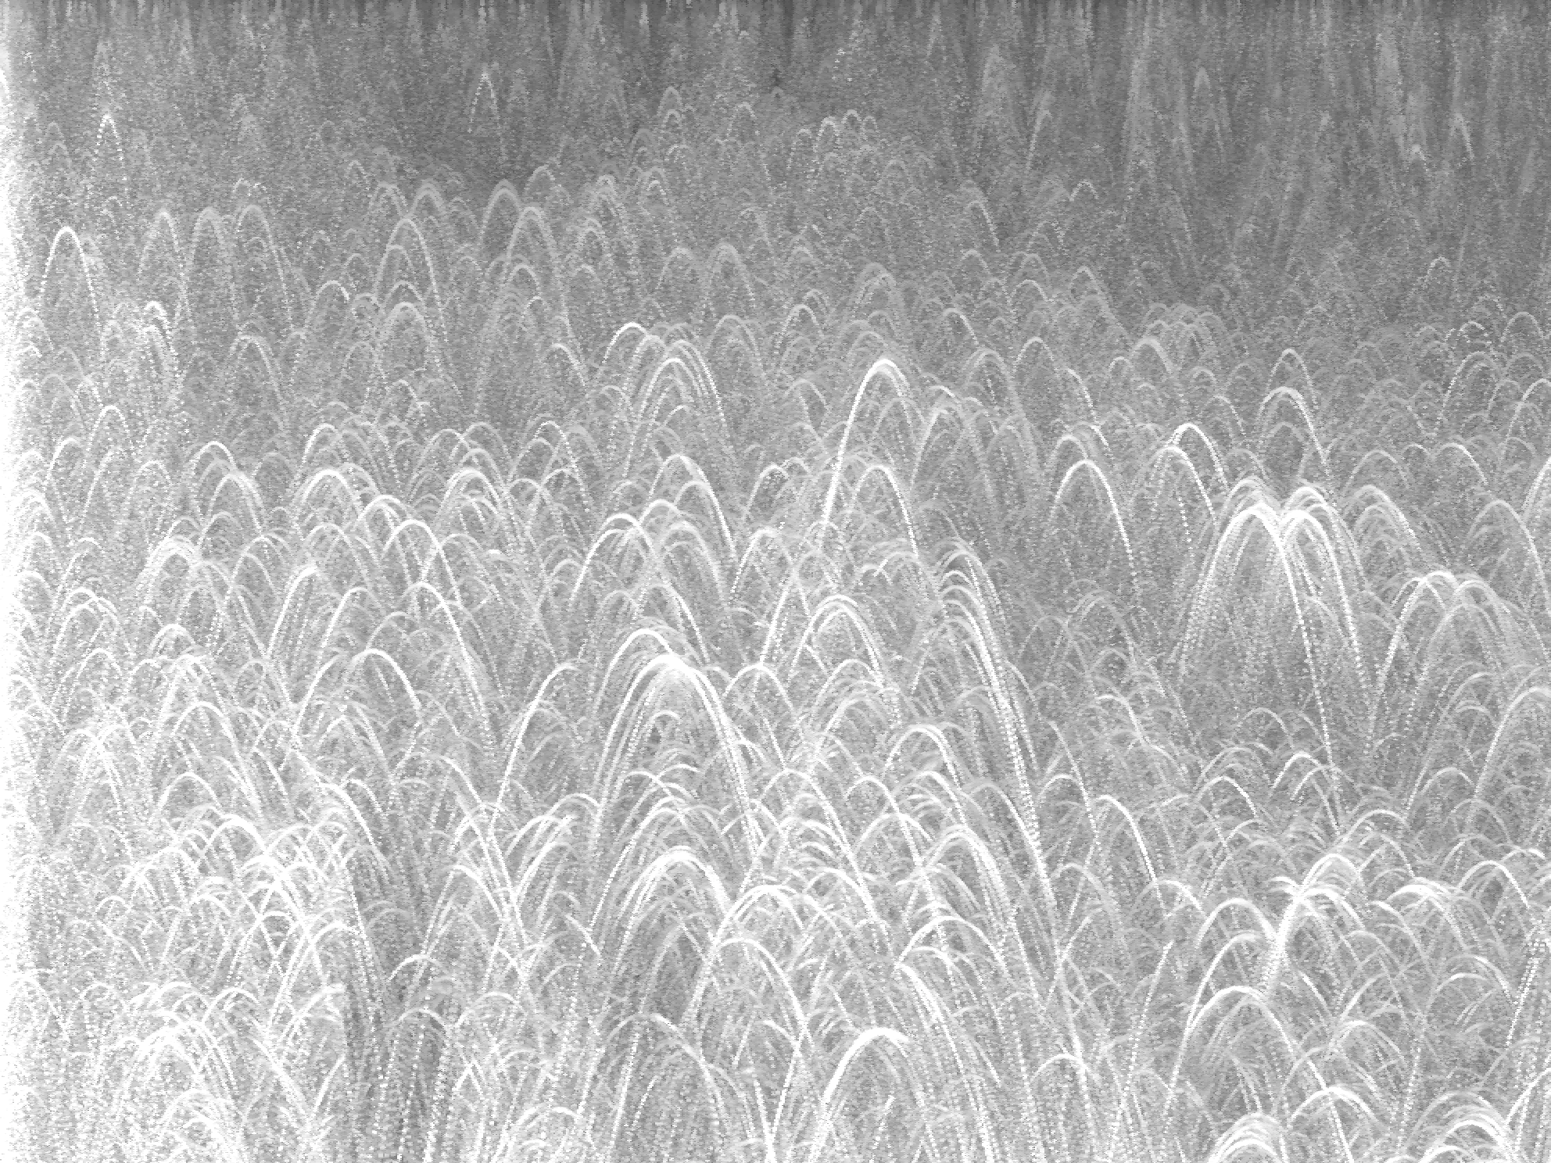
Exploring the hidden diffracted wavefield

Slide 30
Summary & conclusions
Wavefront-based workflow for automated single-channel data inversion using diffractions
Key ingredient: Access of diffracted background wavefield through adaptive subtraction of the reflection foreground
Industrial data example: single-channel workflow could largely reproduce the multi-channel result
Academic data example: Laterally resolved velocity structure and diffraction locations consistent with known fault systems

Slide 31
Summary & conclusions
Wavefront-based workflow for automated single-channel data inversion using diffractions
Key ingredient: Access of diffracted background wavefield through adaptive subtraction of the reflection foreground
Industrial data example: single-channel workflow could largely reproduce the multi-channel result
Academic data example: Laterally resolved velocity structure and diffraction locations consistent with known fault systems

Slide 32
Summary & conclusions
Wavefront-based workflow for automated single-channel data inversion using diffractions
Key ingredient: Access of diffracted background wavefield through adaptive subtraction of the reflection foreground
Industrial data example: single-channel workflow could largely reproduce the multi-channel result
Academic data example: Laterally resolved velocity structure and diffraction locations consistent with known fault systems

Slide 33
Summary & conclusions
Wavefront-based workflow for automated single-channel data inversion using diffractions
Key ingredient: Access of diffracted background wavefield through adaptive subtraction of the reflection foreground
Industrial data example: single-channel workflow could largely reproduce the multi-channel result
Academic data example: Laterally resolved velocity structure and diffraction locations consistent with known fault systems

Slide 34
Acknowledgments
German Research Foundation (DFG, SCHW 1870/1-1)
Wave Inversion Technology (WIT) consortium
Marcel Ruhnau
Christian Hübscher
TGS Nopec
Karin Sigloch & Tarje Nissen-Meyer

Slide 35
Outlook
Exclude / account for out-of-plane energy
2D / 3D P-cable data application (in progress)
GPR application (in progress)
Link event contributions via image segmentation
Explore links to interferometry

Slide 36
Kinematic redundancy
Reflection: Moveout is predominantly a function of offset
(Hertweck et al., 2007)

Slide 37
Kinematic redundancy
Diffraction: Moveout is the same in midpoint direction!
(Hertweck et al., 2007)

